Slide 1
Your career.
Inspired.
Spring 2018
June 13, 2018

Slide 2
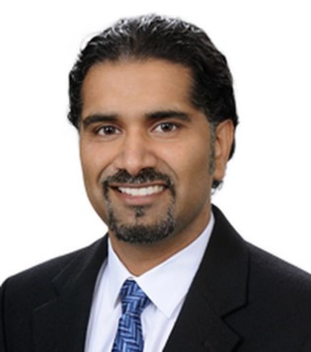
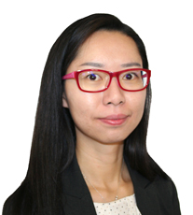
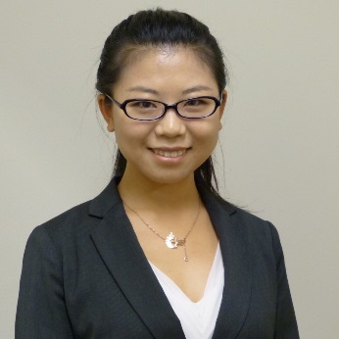

Who are our team members?
KPMG Lighthouse
Data Scientist
Sreekar | Managing Director
PhD, Arizona State University |
BE, Bangalore University
Data Scientist
Yi Liu | Manager
PhD, Univ. of Wisconsin Madison | BS, Peking University
Data Scientist
Yiwen | Manager
PhD, North Carolina State University | BS, Shangai University
Data Scientist
Amanda | Senior Associate
MS, Yale University |
BSE, University of Connecticut
“Having worked in technology industry for over 3.5 years, I realized that my machine learning and AI background was not being used to the fullest extent while been steeped in product development. Joining KPMG was a fundamental breakthrough for me to use my skills in various industries, across varied problem areas. These days I work as a data scientist, an AI Architect, a business person and finally as a teacher. Its fulfilling to be part of projects right from concept to execution.”
“I am trained in statistics, and have strong interest in probability theory, statistical modeling, and machine learning. At Lighthouse, I get to use what I learnt to solve business problems spanning across various industries. Have worked on numerous projects such as AI-based trading signal forecast for corn, stock return forecast using high-frequency data and machine learning, credit loss forecast for various loans, generating economic scenarios using numerous indicators.“
“Believing in the data driven approach, I have been applying my training in the PhD program to tackle practical business questions. During the 4 years-time at D&A Lighthouse, I have been working with multiple Fortune 500 clients in financial service, energy, and IT industries, helping the C-suite stakeholders with their urgent concerns using my core strength as a Data Scientist.”
“Having joined Lighthouse as a campus
recruit allowed me to expand both my
analytical and technical skills, while also
developing my consulting skills and
learning the language of business. Have
got an opportunity to work on variety of
Big Data projects, where we’ve solved
various business related challenges using
cutting edge technologies. Had the
opportunity to compete in global-hackathon,
in which we were able to develop a
solution with a real impact on saving lives.”

Slide 3



Our history
KPMG Lighthouse
Center of Excellence for Advanced Analytics drives Data & Analytics (D&A) at the world’s largest enterprises
KPMG’s portfolio of Artificial Intelligence Capabilities –
KPMG is a Global Firm
Data Components
Algorithms and Tools
154
700+
Offices
Text/
Semi-Structured
Image
Speech
Structured data
Unsupervised learning
Supervised learning
Reinforcement learning
Knowledge-based systems
Natural language generation
Natural language processing
Deep learning
Countries
10+
Major offices
$26.4B
200k+
Professionals
In Revenue
250+
Members
KPMG US Lighthouse Data & Analytics CoE
Data Scientists
Ignition Centers & Insights Centers
Part of a global network of 6 Lighthouse Centers of Excellence
BD/SWE
D&A Consultant
Focus on collaboration and client delivery
~50 PhD resources, and 130 with advanced degrees
D&A Modeler
D&A Engineer
Partnerships and Alliances

Slide 4
How do we serve clients?
The Lighthouse specializes in two broad categories of advanced analytics engagements.
Modeling & Engineering
Deployment of technology‑enabled analytics solutions to answer our clients’ specific business problems
Strategic Transformation
D&A strategy and transformation services that assist clients in developing their own in‑house D&A capabilities

Slide 5


What do we do?
KPMG Lighthouse
Our portfolio of services focus on solving our clients’ specific business needs, or enabling them to develop D&A capabilities. This takes a strong combination of analytics experience, trustworthy data, and industry/functional knowledge to properly frame the problem and develop continuously self‑improving insights.
Analytical modeling
Data visualization
Analytics strategy
Optimization
Predictive modeling
Sentiment analytics
Supervised/ unsupervised machine learning
Cognitive intelligence
Statistics/clustering
Decision science
Business intelligence (Discovery)
Interactive dashboards, reports, & scenario tools
Design‑thinking in UI/UX
D&A strategic assessment
D&A target operating model & implementation
Idea generation workshops
Data engineering
Big data systems
Information extraction
& retrieval/ETL
Unstructured data processing
Text mining & natural language processing (NLP)
Big Data architecture
Data aggregation/
integration
Application design & build (Cloud or On‑prem)
Hosting

Slide 6
Can we do real data science?
KPMG Lighthouse
Lighthouse resources are proficient in the latest data analytics and statistical skills.
Lighthouse resources are proficient in the latest data analytics and statistical skills.
Statistics & modeling
Bayesian Data Analysis
Discrete Choice Models
Exploratory Data Analysis
Linear Regression
Monte Carlo Methods
Panel data/longitudinal data
Statistical Estimation Adaptive Filtering
Survival Analysis
Time series analysis
Advanced Regression
Supervised techniques
Decision Trees
Ensemble Methods
Random Forests
Logistic Regression
Deep Neural Networks
Support Vector Machines
Decision science/ops research
Decision Theory
LP/Mixed Integer Programming
Stochastic Processes & Queuing Theory
Data mining & machine learning
Dimension Reduction
Feature Selection
Large‑Scale Machine Learning & Algorithms
Social Network Analysis and Mining
Ensemble Methods and Random Forests
Supervised Techniques: SVM
Supervised Techniques: Neural Networks
Supervised Techniques: Decision Trees
Supervised Techniques: Logistic Regression
Unsupervised Learning & Clustering:
(K‑Means, LDA)
Natural language processing (NLP)
Machine Translation
Named Entity Recognition (NER)
Part‑of‑Speech Tagging
Sentence Parsing and Chunking
Sentiment Analysis & Text Classification
Topic Modeling & Key Phrase Extraction
Word Sense Disambiguation
Unsupervised learning & clustering
Unsupervised Learning & Clustering
K‑Means
LDA
Information extraction & retrieval
Document Clustering
Fuzzy Matching and Term Weighting
Link Analysis
Web Crawling
Web Scraping
Big data architecture
Cloud Computing
MapReduce
Stream Processing

Slide 7





















What technologies do we use?
KPMG Lighthouse
The Lighthouse has a technology stack comprised of open source & commercial technologies.
Lighthouse professionals are best-in-breed & platform agnostic.
Lighthouse team has extensive experience in using efficient and effective combinations of technologies to solve complex client problems.
Extract, Transform,
Load (ETL)
Data
Storage &
Database Systems
Data
Advanced
Analytics
Visualizations
Insights
kpmg
Proprietary Data
Client Data
Big Data
sFTP
QlikView
Third‑party Data
Microsoft Azure
Data Factory
Mosaic
Unstructured/
Web data

Slide 8

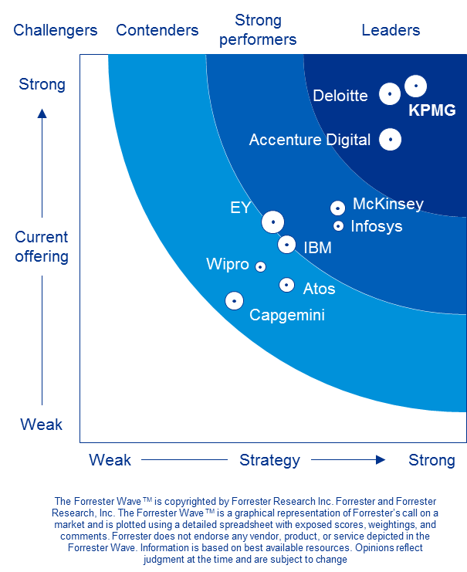
What does the industry think?
KPMG Lighthouse
Industry analysts have placed KPMG Data & Analytics among their top-ranked analytics service providers.
Forrester WaveTM
Insight Service Providers
Q1 2017
Within 3 years Gartner has moved KPMG Data & Analytics up in its rankings
“
KPMG cracked the code for balancing business and technology expertise. KPMG comes to the table with an impressive portfolio of data and analytic 3s capabilities, brought together in its Lighthouse Center of Excellence (CoE).
2014
Niche
This looks like we are getting worse, or just moving around the edges, vs. getting closer to top right?
2015
Visionary
Recognizing the importance of trust
in an insights provider, KPMG’s comprehensive approach to bridging a potential ‘trust gap’ includes collaboration to define business objectives, design engagements, and deliver results.
2016
Leader
”
-Industry analysts at Forrester

Slide 9
Our people
KPMG Lighthouse
A dedicated team of 250+ professionals across the U.S. with advanced D&A skills.
Data Scientists
Big Data Software Engineers
Strong experience in analytics, statistics, data mining, machine learning, natural language processing and/or mathematics
Problem-solving ability through the use and/or development of algorithms, models, testing, etc.
Generally MS or PhD-level math, statistics, or engineering
Strong experience with large scale and/or distributed processing, using Hadoop, Storm, Spark, and many others
Sophisticated ability to rapidly ingest, transform and mine data
Ability to evaluate, design, build, test and manage “big data” architectures
D&A Modelers
D&A Engineers
Strong business consulting acumen and statistical background, combined with real‑world experience in developing analytics models to solve business issues
Practical, hands-on understanding of advanced analytics methods and big data software; strong experience in providing effective & efficient client solutions
Strong experience working in teams to perform ETL (Extract, Transform and Load) of data from variety of databases, from SQL, NoSQL, HDFS
Expert ability to engineer efficient data platforms for analytics systems, including visualizations and machine learning pipelines

Slide 10
Join recruiters in text chat to learn more about career opportunities on the Lighthouse team!
Register here: http://bit.ly/2NcgB0P

Slide 11
Some or all of the services described herein may not be permissible for KPMG audit clients and their affiliates.
kpmg.com/socialmedia
The information contained herein is of a general nature and is not intended to address the circumstances of any particular individual or entity. Although we endeavor to provide accurate and timely information, there can be no guarantee that such information is accurate as of the date it is received or that it will continue to be accurate in the future. No one should act on such information without appropriate professional advice after a thorough examination of the particular situation.
© 2018 KPMG LLP, a Delaware limited liability partnership and the U.S. member firm of the KPMG network of independent member firms affiliated with KPMG International Cooperative (“KPMG International”), a Swiss entity. All rights reserved. NDPPS 761073
The KPMG name and logo are registered trademarks or trademarks of KPMG International.

